Slide 1

Huanyue Chen, Shoukang Hong, Wanjun Yu

Slide 2
Screen list
There are in total xx screens for our app including:
Login/Register screen
Home screen
Recycler grid for each event.
Event screen
Recycler row for each participant.
Post screen
Profile screen
Setting Screen
Follower/Following manager screen
Recycler row for each follower/following user
Chat list manager screen
Recycler row for each chat
Chat room screen
Recycler row for each receiver and sender message

Slide 3
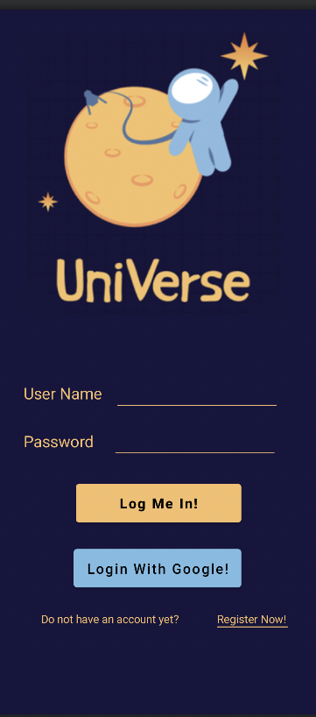
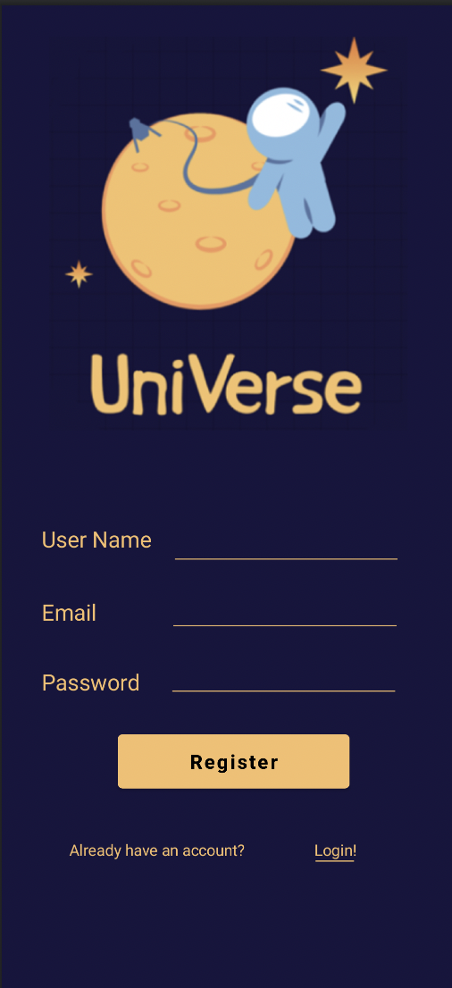
Login / register screen
This is login/register screen
We will build these two screens for users to login or register.
Login screen will be populated by ‘Login’
Register screen will be populated by ‘Register’

Slide 4
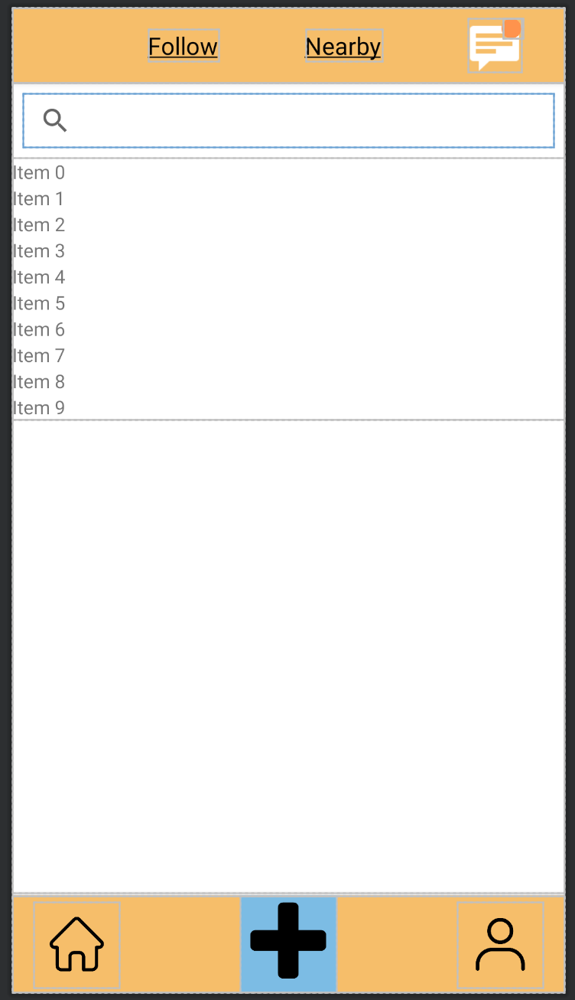
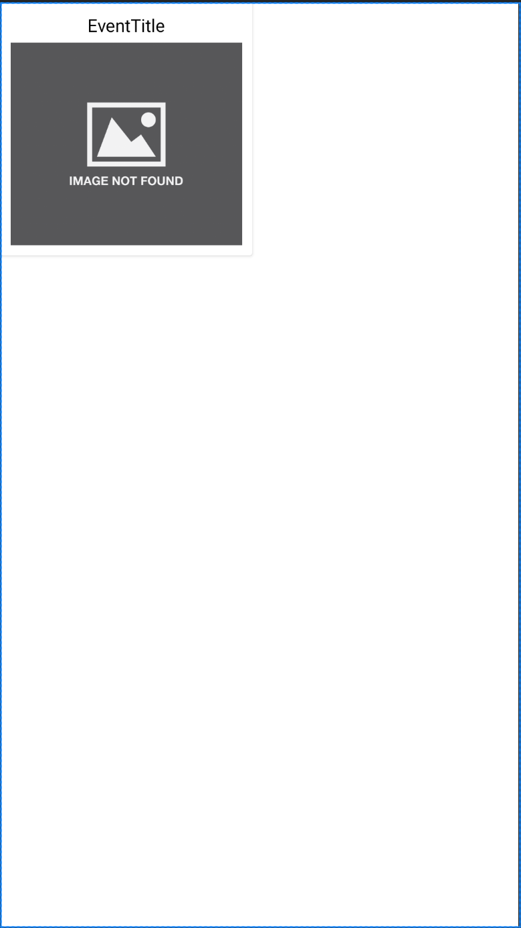
Home Screen
This is the home screen, which contains 2 column of events and essential buttons to navigate to different pages.
Home Screen will be populated by HomeFragment
We will build the participant list using RecyclerView. Each grid of the RecyclerView is rendered from the Layout home_events_recycler_row.xml.
Recycler View
One row in the Recycler View

Slide 5
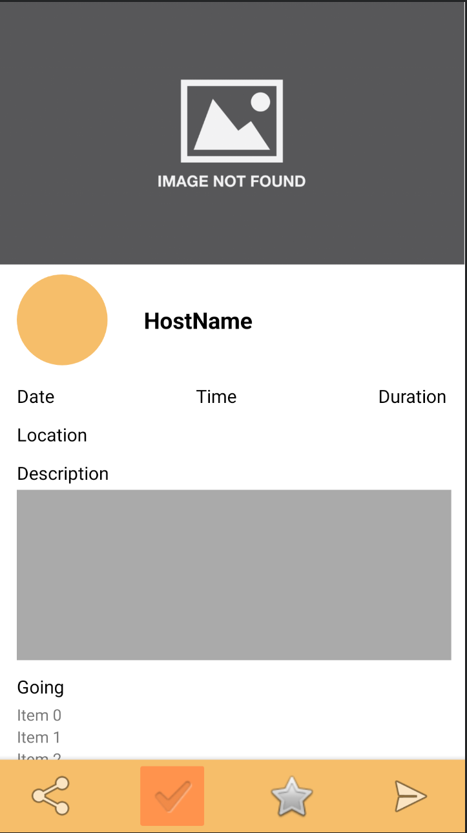
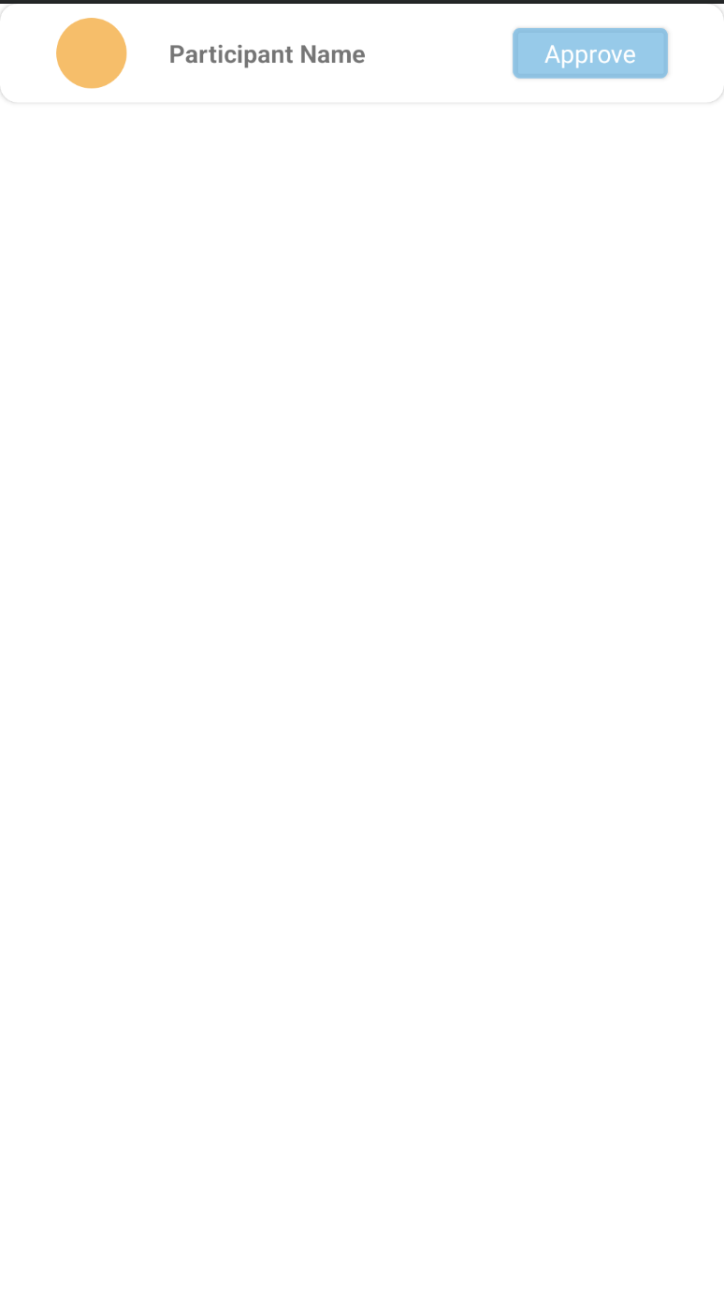
Event Screen
This is the event screen, which includes information of an event, a list of participants, and buttons to interact with the event.
Event Screen will be populated by EventFragment
We will build the participant list using RecyclerView. Each row of the RecyclerView is rendered from the Layout participant_recycler_row.xml.
One row in the Recycler View
Recycler View

Slide 6
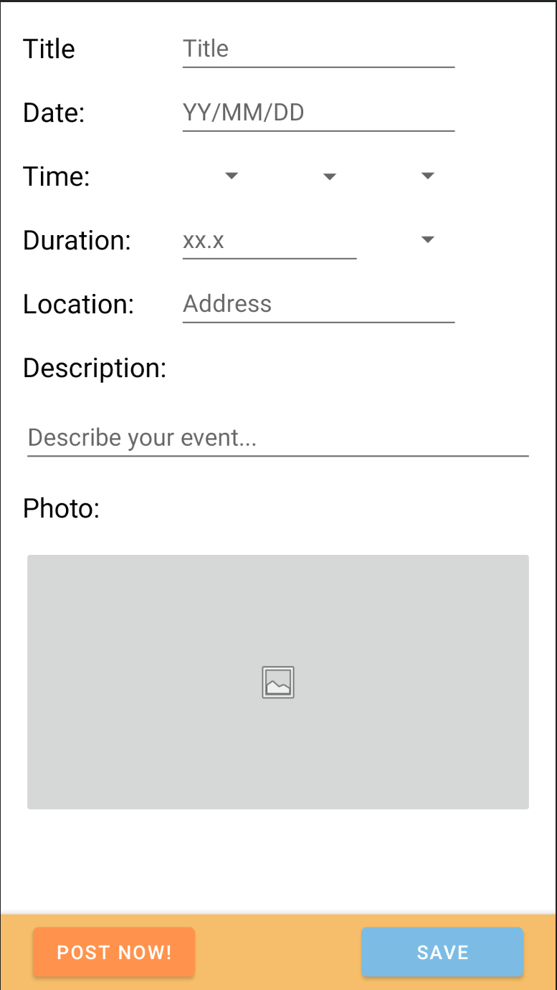
Post Screen
This is the post screen, which contains input areas for users to setup and post event info.
Post Screen will be populated by PostFragment

Slide 7
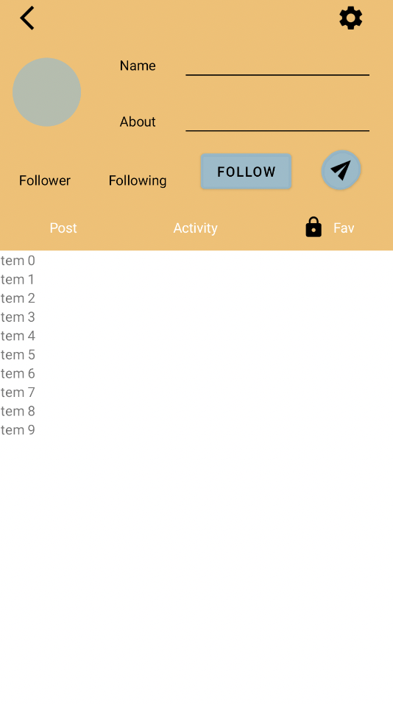
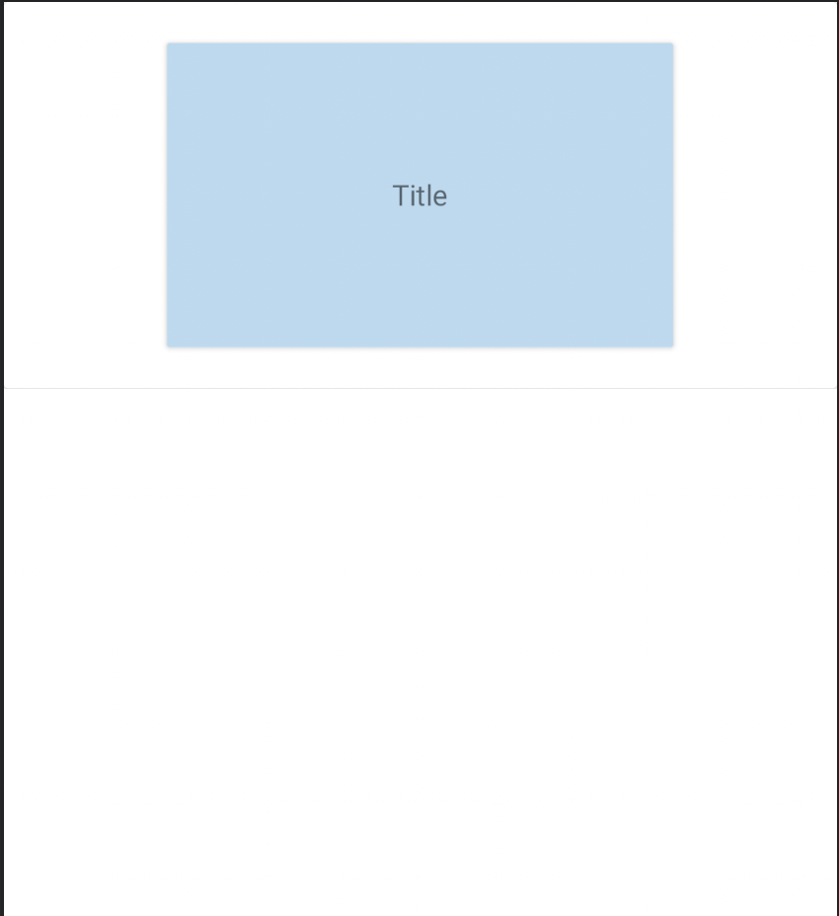
Profile screen
This is profile screen will be populated by ‘Profile’. This screen contains a list of the activities the user posted, all the activities the user joined or the activities a user added to favorite.
We will build the list using RecyclerView. Each row of the RecyclerView is rendered from the Layout events_row.xml.
Since we add a customized toolbar inside, users can hide their information by scrolling down the list of activities.
One row in the Recycler View

Slide 8
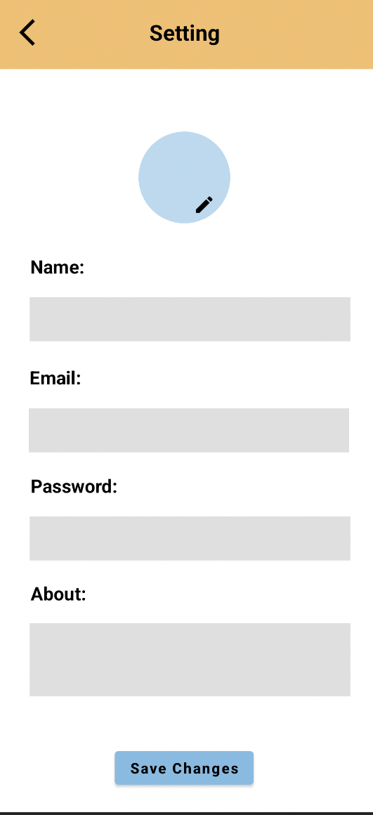
Setting screen
This is setting screen which will be populated by ‘Setting’
We will build an imageview for user to update user’s icon, four edittext for user to update user’s information and a button to save the changes.

Slide 9
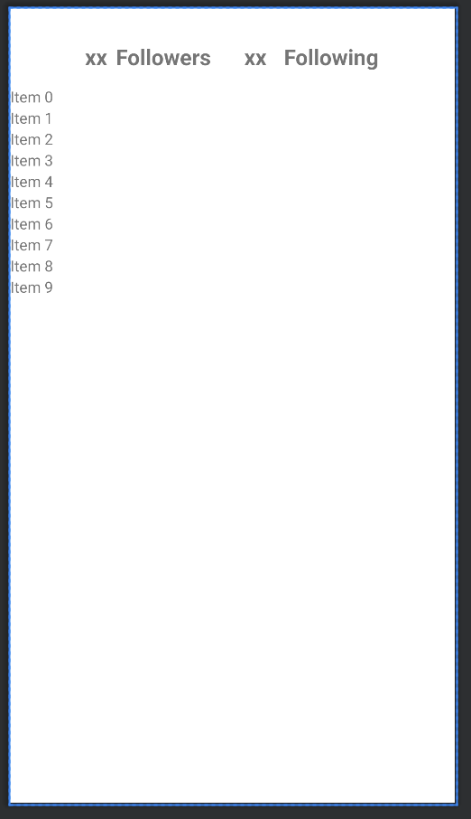
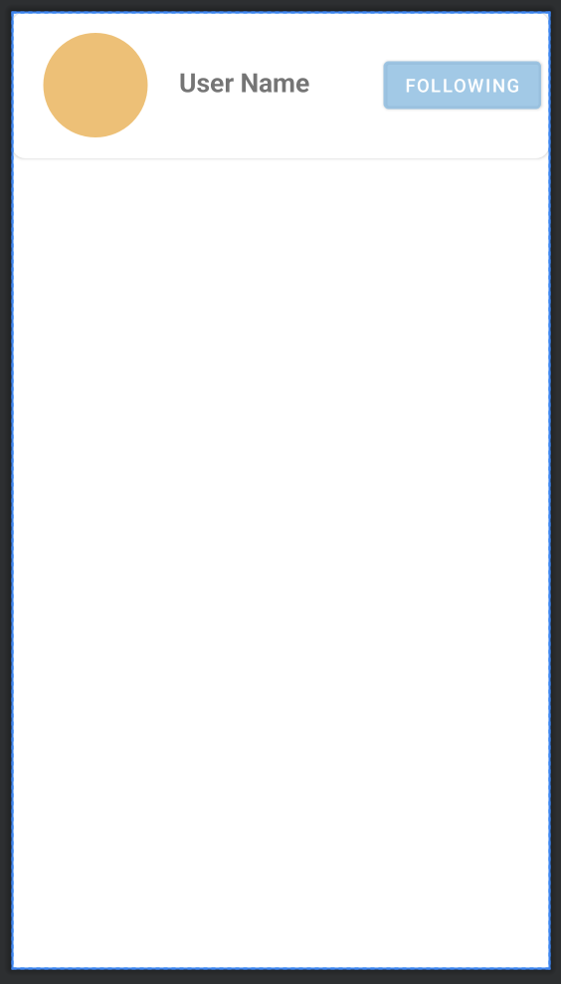
Follower Manager Screen
This is the Follower/Following manager screen, which contains a list of followers/following users.
We will build the list using RecyclerView. Each row of the RecyclerView is rendered from the Layout followers_recycler_row.xml.
Recycler View
One row in the Recycler View

Slide 10
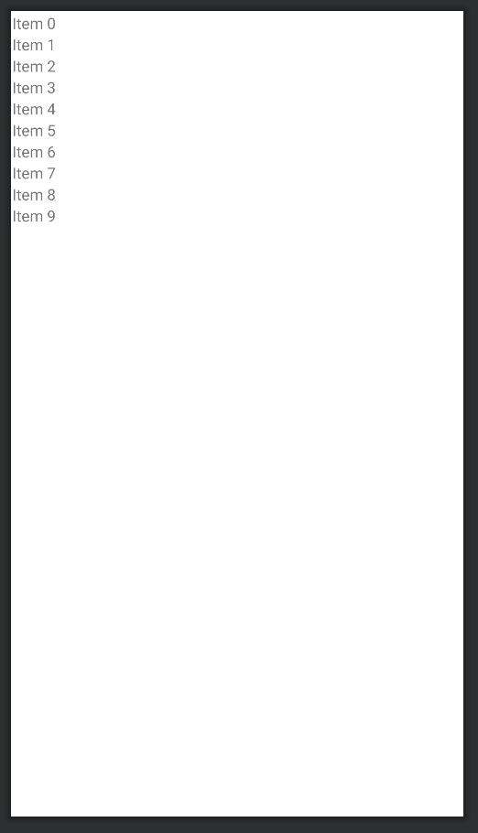
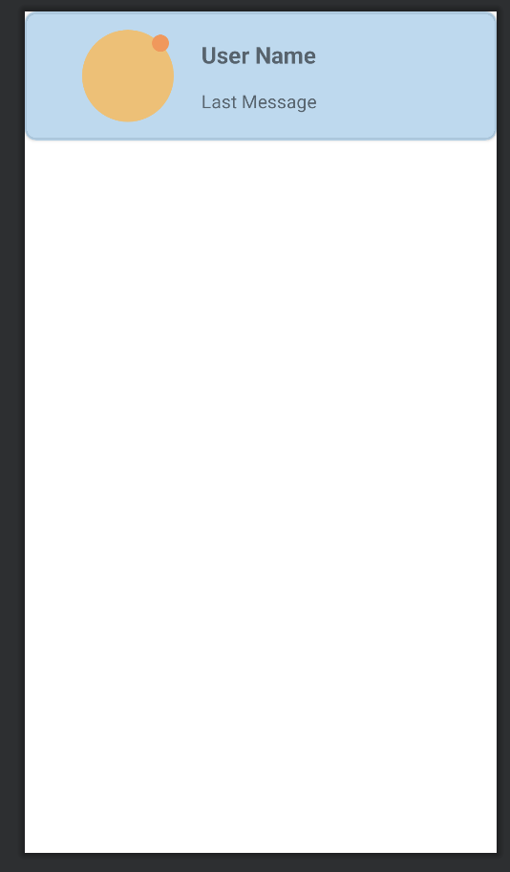
Chat list Manager Screen
This is the chat list manager screen, which contains a list of chat rooms.
We will build the list using RecyclerView. Each row of the RecyclerView is rendered from the Layout chatmanager_recycler_row.xml
The recycler row will include the user profile photo, user name and latest message. When there is an unread message, there will be an orange dot on the top right of the user profile photo
Recycler View
One row in the Recycler View

Slide 11
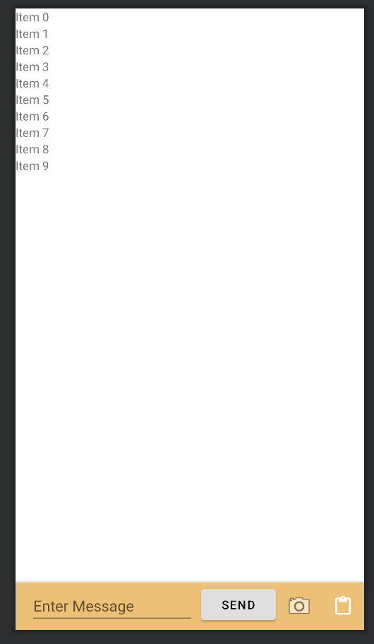
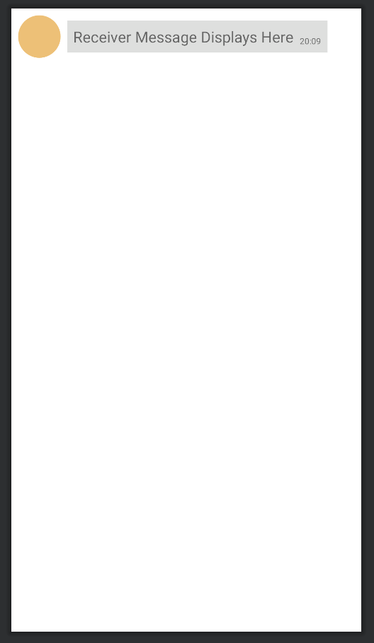
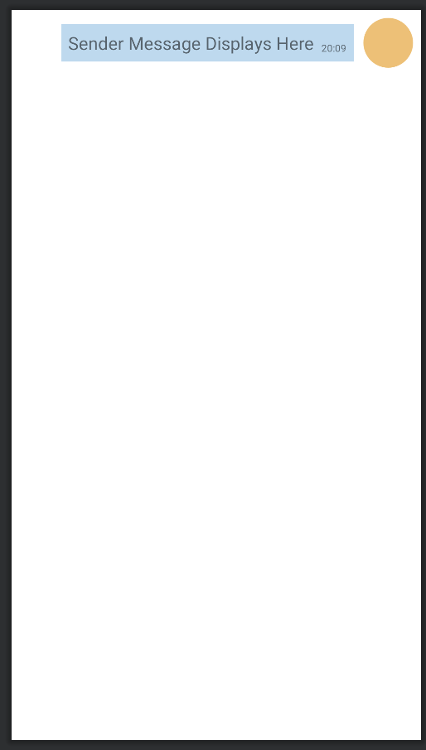
Chat Room Screen
This is the chat room screen, which contains a list of messages in the room.
We will build the list using RecyclerView. The receiver message will be rendered by Layout receiverchat.xml, while the sender message will be rendered with Layout senderchat.xml
Recycler View
One row in the Recycler View – Receiver Message
One row in the Recycler View – Sender Message

